Slide 1
Theory of Revenue
What is Revenue
Total Revenue, Marginal Revenue and Average Revenue
Relation between TR, MR, AR (when price is constant and when price is not constant)

Slide 2
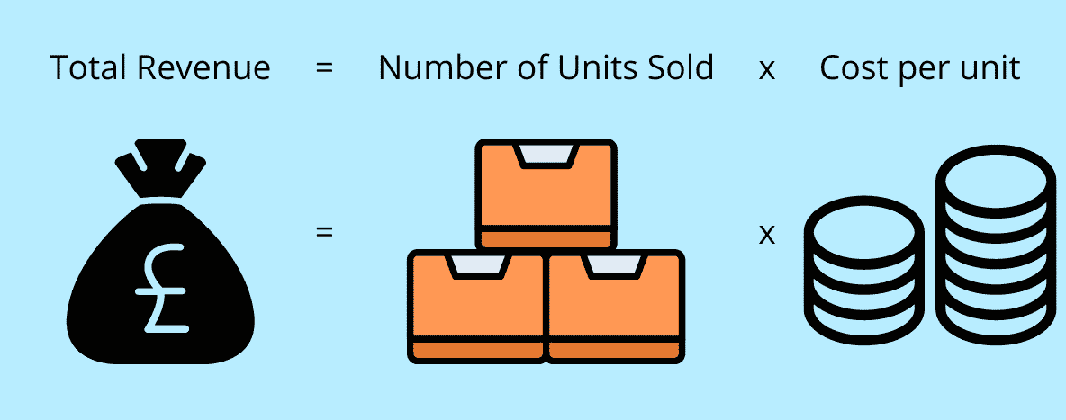
What is Revenue?
Revenue refers to the total amount of money generated by a business from its primary activities, such as the sale of goods or services, during a specific period of time.
It is the income earned by a company before deducting any expenses.
Revenue=Number of Units Sold × Price per Unit

Slide 3

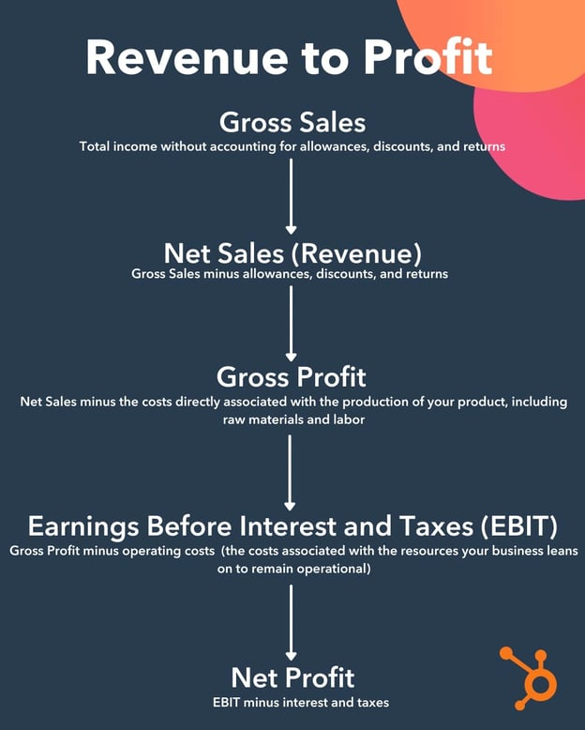
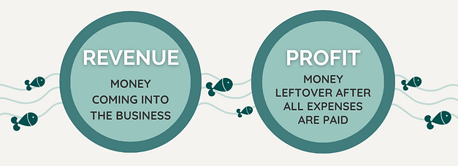
Notes:
Revenue is the amount received by an organization from the sale of a given quantity of a commodity in the market. Simply put, is the amount of money received by a producer for the sale proceeds. For example, if a firm gets ₹20,000 by selling 100 tables, then ₹20,000 will be the revenue of the firm.
Revenue is an essential concept in the analysis of an economy. Sales level has a direct impact on revenue. It means that if sales increase, then revenue will also increase. Revenue is not the same as Profit. Revenue is the sale proceeds; however, Profit is the excess of revenue over costs.
Revenue is the total income a business generates through its sales. Profit is the portion of that income that remains after subtracting that company's operating costs, debts, taxes, and any other expenses it incurs in the interest of generating revenue.
You need to have a consistent picture of your business's revenue and profit if you want to reliably gauge its financial health and viability. Both metrics can be telling into the effectiveness of your sales and marketing efforts along with the efficiency of your spending.
It takes some steps to pare down your revenue figure to your profit. Let's take a look at how you can get from one to the other.
Starting With Gross Sales
A company's gross sales is the most fundamental measure of the income it generates — without accounting for allowances, discounts, and returns. It's the product of the number of units of a product or service a business sells and the price those units are sold at.
In some respects, it could be considered a type of revenue — but it doesn't accurately reflect the income a business brings in and usually isn't listed on an income statement.
Getting from Gross Sales to Net Sales
Net sales is a much more practical reflection of a company's overall revenue. It accounts for all the sales a company makes but considers three key factors that impact the price a product or service might be sold for:
Allowances — Retroactive discounts a buyer receives after they discover and report some sort of defect with a product.
Discounts — Reductions in price a seller offers a buyer in exchange for immediate or early payment.
Returns — Partial or full refunds buyers receive for sending a product back to a buyer.
Once those elements have been folded into a company's financial reporting, that business has a clearer picture of its actual revenue. For more information on the difference between gross and net sales, check out this article.
Getting from Net Sales to Gross Profit
Once you've established your net sales, you can calculate your gross profit by subtracting the cost of goods sold (COGS) — the costs directly associated with the production of your product, including raw materials and labor — from your net sales figure.
Getting from Gross Profit to Earnings Before Interest and Taxes (EBIT)
After calculating your gross profit, you would whittle that figure down to earnings before interest and taxes (EBIT) (also known as operating profit) by subtracting your operating costs — the costs associated with the resources your business leans on to remain operational, including employee salaries, rent, legal fees, sales expenses, and marketing costs.
Getting from EBIT to Net Profit
As you can probably assume, you can find your net profit by subtracting the value of any interest or taxes you incur from your earnings before interest and taxes. That final figure is the most accurate reflection of your company's profitability over a given period
Revenue vs. Profit Example
Starting With Gross Sales
Let's say a manufacturer moved 5,000 orders of 1,000 units at $1 per unit in the past fiscal year. In that case, the company's gross sales would be $5,000,000.
Getting from Gross Sales to Net Sales
Now, let's imagine that of those 5,000 orders, 100 buyers reported defects and each received an allowance of $0.15 per unit. Another 100 received a discount of $.05 per unit for paying for their order in full upon their initial purchase. And another 100 returned their purchase for a $0.50 per unit refund. That would mean the company would have to account for:
$15,000 in allowances
$5,000 in discounts
$50,000 in returns
Taken together, those deductions would chip into the company's gross sales by $70,000 — leading to a net sales (or revenue) figure of $4,930,000. Alternatively, if you're already using revenue intelligence software, you could skip the past steps and move directly to gross profit.
Getting from Net Sales to Gross Profit
From there, the company would subtract its COGS from its net sales to get its gross profit. Let's say it takes $0.25 in raw materials and labor costs for the company to produce each individual tennis ball — so the COGS for the 5,000 shipments the manufacturer moved would amount to roughly $1,250,000. That would make the company's gross profit $3,680,000.
Getting from Gross Profit to Earnings Before Interest and Taxes (EBIT)
Once the manufacturer has its gross profit, it would find its earnings before EBIT by subtracting its operating costs. Let's say the company spends $2,500,000 annually on employees' salaries, $200,000 annually on rent for its facilities, $100,000 on its marketing efforts, $15,000 in accounting fees, and $10,000 on travel expenses for its salespeople.
Assuming that's all it takes to keep the business operational, its operating costs would be $2,825,000. That would make the company's EBIT $855,000.
Getting from EBIT to Net Profit
Once its earnings before interest and taxes have been established, the company would find its net profit by (you guessed it) subtracting the interest and taxes it pays. Let's say those fees amount to 35% of the company's income. That means the business would pay $299,250 in interest in taxes — making its net profit $555,750.
So as you can see, there's a pretty sizable gap between the company's revenue ($4,930,000) and its net profit ($555,750).

Slide 4
Total Revenue
It refers to the total amount of money that a company earns through the selling of its goods and services, over a time period (a day, week, month or year).
The nature of total revenue depends on the market where products are sold and produced (government regulation, price elasticity)
TR = p x q
where,
p = price of the product
q = quantity that was sold
Notes:
The total receipts from the sale of a given quantity of a commodity are known as Total Revenue. In simple terms, Total Revenue is the total income of a firm and is determined by multiplying the quantity of the commodity sold by its price. The formula for Total Revenue is,
Total Revenue = Quantity x Price
For example, if a firm sells 100 tables for ₹200 each, then the Total Revenue of the firm will be 100 x 200 = ₹20,000.

Slide 5
Average Revenue
It refers to the amount of money earned per individual unit or user. The average revenue is the total revenue amount divided by the quantity.
AR = TR / Q
where:
AR = Average revenue
TR = Total revenue
Q = Quantity of units or users
The average revenue allows a company's investors or management team to analyze revenue generation capability and forecast future growth.
Notes:
The revenue per unit of the output sold of a commodity is known as Average Revenue. It is determined by dividing the Total Revenue by the number of units sold of a commodity. The formula for Average Revenue is, AR= Total Revenue/ Quantity
For example, if the Total Revenue of a firm is ₹20,000 by selling 100 tables, then the Average Revenue will be, AR= 20,000/100= 200
Average Revenue (AR) and Price are the same
As we know, Average Revenue is the per unit sales receipt of a commodity and price is always per unit. Now, as the sellers receive revenue based on the price of the commodity, Price and Average Revenue are one and the same thing.
Explanation:
TR = Quantity x Price ……………………. (1)
AR= TR / Quantity …………………….. (2)
Now, by putting the value of (1) in (2), we get AR= Quantity x price/ Quantity
AR = Price

Slide 6
Average Revenue and Price
Average revenue and price are always equal under all market forms.
Average revenue is the revenue per unit of output sold. AR=TR / Q …..(i) and that, TR=P × Q …..(ii)
where, P = Price per unit and Q = Quantity sold. Now, putting the value of TR from equation (ii) in equation (i) AR= (P×Q)/Q=Price
Thus, AR is always equal to price.

Slide 7
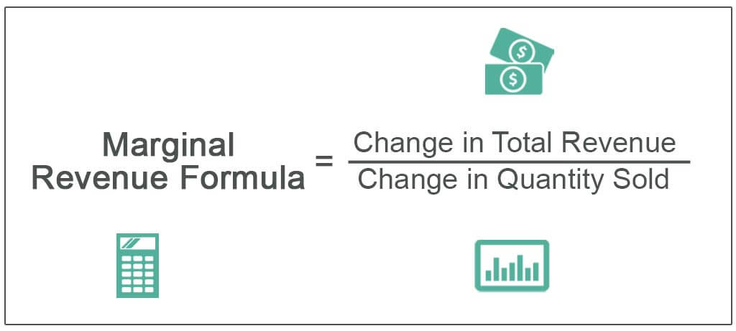
Marginal Revenue
It refers to the additional revenue earned by setting an additional unit of a product in the market.
Notes:
Marginal revenue remains constant till a certain level of output is achieved. It then slows down with increasing output by following the law of diminishing returns.
The additional revenue generated by selling an additional unit of output is known as Marginal Revenue. In simple terms, it is the change in Total Revenue from the sale of one more unit of a commodity. The formula for Marginal Revenue is,
MR_{n} = TR_{n} – TR_{n-1}
Where,
MR_{n} = Marginal Revenue of the n^{th} unit
TR_{n} = Total Revenue from n units
TR_{n-1} = Total Revenue from n-1 units
n = Number of units sold
For example, if the total revenue generated from the sale of 100 tables is ₹20,000 and from the sale of 101 tables is ₹20,500; then the Marginal Revenue of the 101st table will be,
MR_{n} = TR_{n} – TR_{n-1}
MR₁₀₁ = 20,500 – 20,000 = ₹500
One more way to calculate MR
As we already know, Marginal Revenue is the change in TR when one more unit of the output is sold. However, when the change in units of output sold is more than one, then the previous formula can be difficult to use. In those cases, MR can be determined by using the following formula:
For example, if the TR from the sale of 100 tables is ₹20,000 and 110 tables is ₹24,500; then the Marginal Revenue will be,
Slope of Total Revenue Curve is represented by Marginal Revenue. It is because

Slide 8
Review Question
From the following table, determine the TR, MR and AR.
Units Sold (Q) | Price (P)
1 | 15
2 | 10
3 | 8
4 | 7
5 | 6
6 | 5
7 | 4
8 | 2

Slide 9
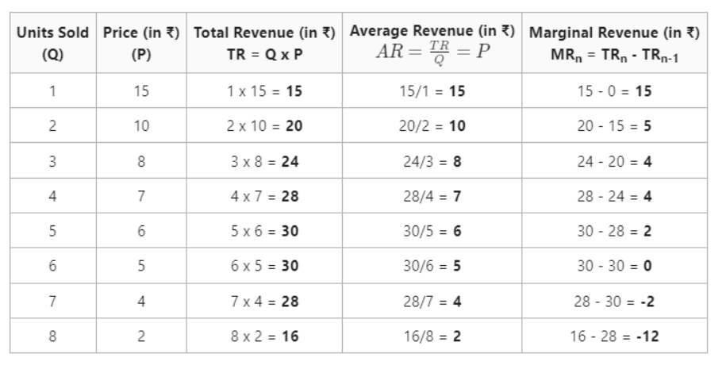
Answer:

Slide 10
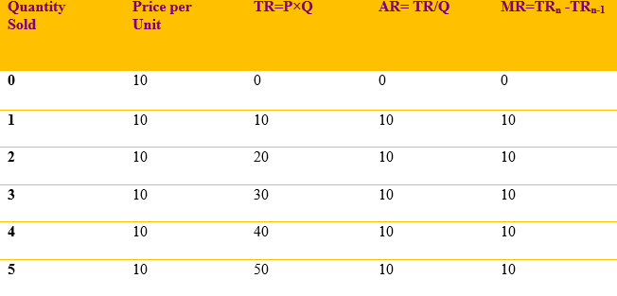
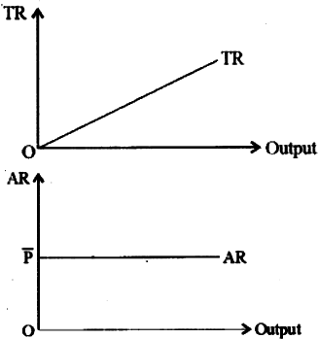
Relation between TR, AR and MR (P is constant) (For ex: in case of perfect competition)

Slide 11
Points to remember…..
When the price of the commodity is constant, then Average Revenue (AR) of a firm is equal to Marginal Revenue (MR) of the firm and both AR and MR are parallel to the X-axis.
AR=MR
Total Revenue (TR) curve is the straight line originating from the origin as TR of the firm increases at a constant rate

Slide 12
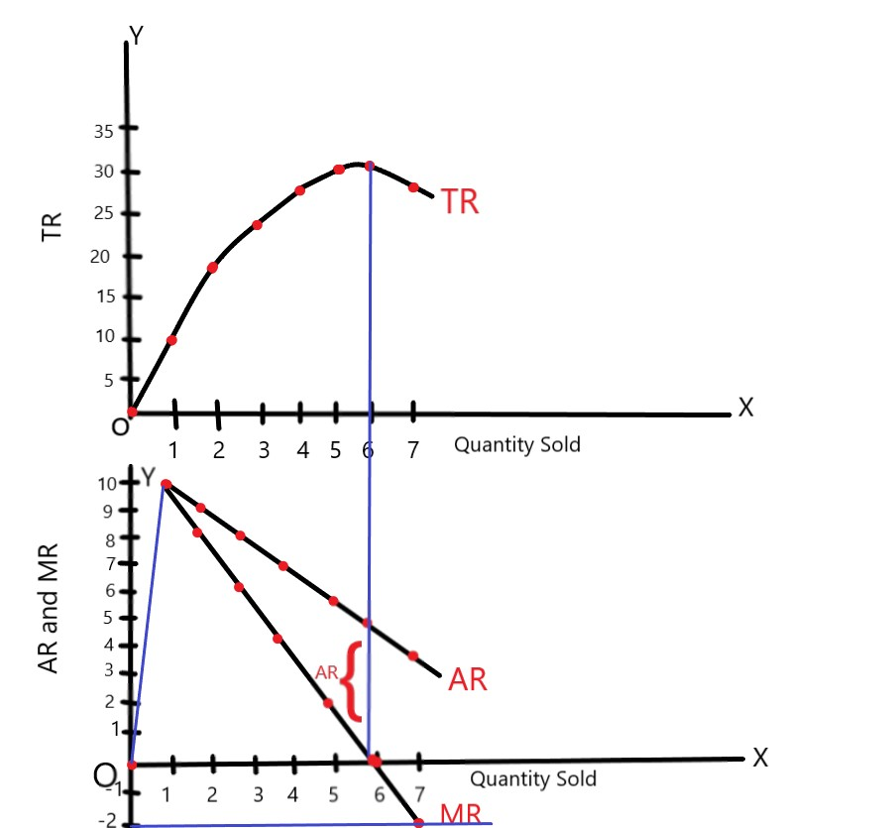
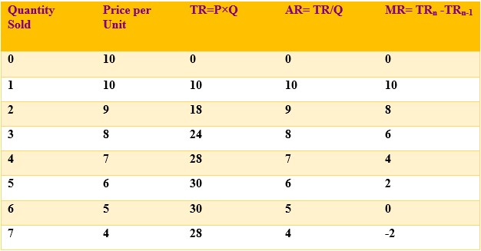
Relation between TR, AR and MR (P is not constant)
Notes:
In markets like imperfect markets, the price tends to fluctuate and adjust according to the market forces of demand and supply. A firm can increase its volume of sales only by decreasing the price, so the AR falls with an increase in sales. The revenue from every additional unit; i.e., MR will be less than AR. As a result, both AR and MR curves slope downwards from left to right.
Both AR and MR fall with an increase in output. However, MR falls at a rate more than the rate of fall in AR, making the MR curve steeper than the AR curve. MR curve can be zero and negative, while AR remains positive.
It must be noted that MR can fall to zero and can even become negative. However, AR can be neither be zero nor negative as TR is always positive.A firm can increase its volume of sales only by decreasing the price, so the AR falls with an increase in sales. MR is the addition to TR when one more unit of output is sold. So, TR will increase when MR is positive, TR will fall when MR is negative, and TR will be maximum when MR is zero.

Slide 13
Points to remember……
When AR declines, MR declines at a faster rate (AR>MR).
When MR declines, TR increases at diminishing rate.
When MR=0, TR achieves its maximum point and become constant.
When MR is negative, TR starts declining.
MR can be zero or negative, but AR can’t be 0 or negative

Slide 14
Break-even point
Break-even Analysis is an economic concept that is used to determine the number of units that needs to be sold by the company to cover the costs and gain no profits.
It is the level of units that a company should at least reach in order to survive in the market. Break-even is a level where a company neither earns any profits nor suffers any losses.
The break-even point tells us the units to be sold in order to cover costs.
Notes:
Break-even Analysis is essential because of the following reasons:
1. Set the number of units to be sold: With the help of break-even analysis, a manager can set a target for the number of units to be sold in order to cover the costs. Variable costs, fixed costs, and the selling price are generally used in the calculation of the break-even point.
×
2. Pricing Strategy: Break-even Analysis tells the company about the selling price; i.e., What selling price can be charged per unit in order to cover the expenses. Also, if the selling price of a commodity is increased, then the number of units of that product to be sold to achieve the break-even point will be reduced. Similarly, if the selling price of a commodity is reduced, then the company will have to sell extra to achieve the break-even point.
3. Setting Targets: The target being set under break-even analysis acts as the goal of the sales team so that they can plan on how and when to sell the units in order to reach the target.
4. Monitors and Controls Costs: Break-even Analysis helps in monitoring the costs occurring in the production process and then control them by cutting down the useless expenses.
5. Manages the Margin of Safety: During financial breakdown, a company’s sales tend to fall. Under those circumstances, break-even analysis helps in deciding the least number of sales that the company needs to make profits. Besides, with the help of margin of safety reports, the management of a company can easily execute high business decisions.
Components of Break-even Analysis

Slide 15
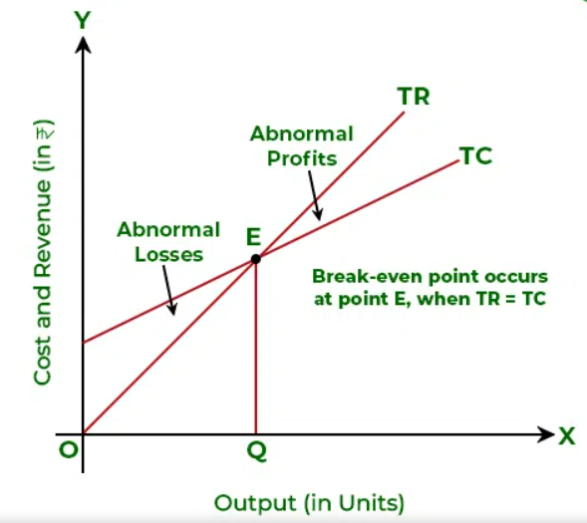
Break-even Analysis
The point where total revenue is the same as the total cost is known as Break-even Point.
At this point, the firm is able to meet all of its costs.
Notes:
In the above graph, X-axis shows units being sold and Y-axis shows the revenue made. The cost line shows the total cost that occurs during the production process, the fixed cost line shows the occurrence of fixed costs, and the revenue line shows the total sales being made. The intersection of the revenue curve and cost curve determines the break-even point; i.e., point E.
In the above graph, we can see that E is the break-even point as Total Revenue at this point is equal to the Total Cost. At point E, the firm has attained normal profits or a No Profit No Loss situation. Any other point below this point represents abnormal losses; however, any point, which is above Point E represents abnormal profits.

Slide 16
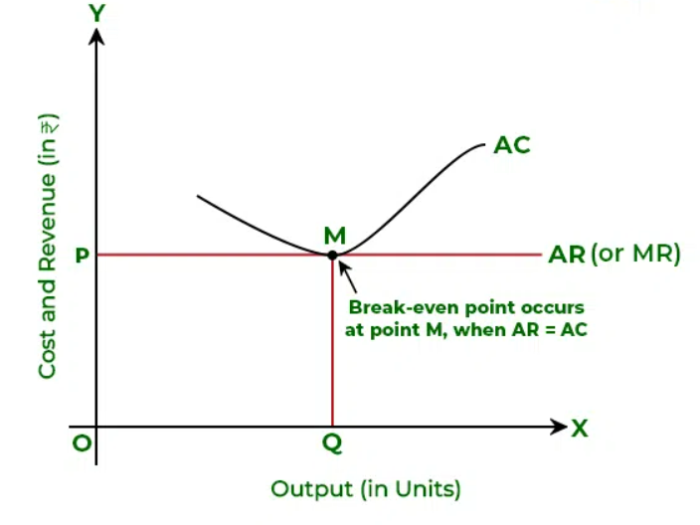
Another method to calculate break-even point
Notes:
Besides the above case, Break-even Point can also be achieved when AR=AC.
As discussed above, the break-even point is attained when:
TR = TC
By dividing both sides by Q (Output), the result will be
AR = AC

Slide 17
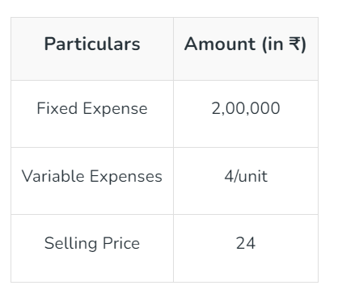
Calculation of Break- even point
Break- even point = Fixed Cost/ Selling price per unit- variable costs
Notes:
The three components of Break-even Analysis are as follows:
1. Fixed Costs: These are the costs that the company has to bear even when there is no production of units. Fixed costs remain constant and do not change with the level of production. Fixed Costs are also known as Overhead Costs. For example, Rent or mortgage, equipment costs, salaries, taxes, insurance premiums, etc.
2. Variable Costs: Variable Costs are the costs that change with the change in output. Variable Costs rise as the production rises and falls when production falls. These costs include packaging costs, wages, cost of raw materials, etc.
3. Selling Price: Selling price is the amount that the seller/company charges the customers in exchange for their product or services. The selling price is determined on the basis of raw materials used for production, wages, fixed expenses, etc.
Following are some of the uses of Break-even Analysis:
1. Change in Business Model: When a company is changing business models like shifting from wholesale business to retail business or shifting from retail business to wholesale business, break-even analysis will help the business in deciding the selling price of the product.
2. Expansion of Business: If a company is deciding to expand its business or launch a new product, the company will do the break-even analysis first to decide on the selling price of the product.
3. Lowering Prices: Sometimes, businesses need to lower down the price of their product so that they can increase their sale and beat the competitors. So, when lowering pricing, businesses need to figure out how many more units they need to sell to offset or make up a price decrease.
Solution:
Here, Fixed Cost = ₹2,00,000; Variable Expense = ₹4 per unit; and Selling Price = ₹24
Break-even Point = 10,000 units
It means that the company would need to sell 10,000 units of the product to attain break-even.

Slide 18
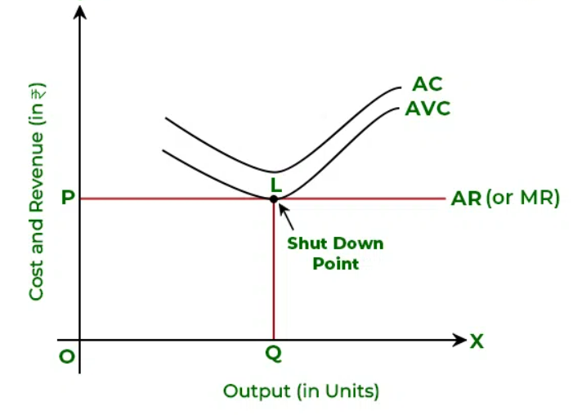
Shut-down point
The situation when a firm is able to cover only its variable costs is known as Shut-down Point.
At this point, the total revenue received from the sale of goods is the same as the total variable costs of production
Notes:
At the shut-down point, a firm incurs fixed cost loss. Even though there is a fixed cost loss, the firm does not stop production as the fixed cost will still be there. However, if the price or AR falls more and is unable to meet even its average variable cost, then the firm will have to shut down its operations. In the above graph, the firm attains Shut-down Point at L, when AR is equal to AVC.

